Slide 1
Harry Gee & Associates, PLLC
Obtaining H-1B Status & Employment-Based Immigration
www.HarryGee.com/UH2017
Andrew H. Gee & Dhiraj Suvarna

Slide 2

Immigration Basics

Slide 3
Immigration Basics
US Immigration is essentially split into two categories: Immigrant (Permanent Residence) and Non-Immigration (Temporary Stay)
US law has a general presumption that all foreign nationals want to come to work and stay
You must qualify for an individual category, not a points system

Slide 4
Non-Immigrant Documents
Petition & Approval
  Sponsor applies for the Position & Beneficiary’s professional qualification with USCIS
  May change or extend status for those already in US
Visa
  Stamp in passport, issued by DOL after individual security check and personal interview
Status / I-94
  CBP officer at port of entry grants foreign nationals admission: class of admission & validity date
  May apply with USCIS to change or extend status within US

Slide 5
Petition Approval Letter

Slide 6
Visa

Slide 7
Admission (I-94) Number
https://i94.cbp.dhs.gov/

Slide 8
Work and Practical Training
You are permitted 12 months of OPT per degree level
365+ days of full-time CPT renders student ineligible for OPT
Student’s responsibility to track
CPT - I-20 needed to work
OPT - Employment Authorization Document (EAD card)

Slide 9
Travel and Practical Training
International travel on CPT is usually fine as the student continues to be enrolled in school
International travel on OPT could be problematic
  F-1 visa expired – Issues with the US Consulate Abroad
    Need to apply for F-1 visa stamping prior to re-entry
    Documenting non-immigrant intent
  F-1 visa valid – Issues with CBP @ Port of Entry
    Proof of employment
    EAD card
    I-20 less than 6 months old
Must enter as an F-1 student

Slide 10
24- Month STEM Extension
Science, Technology, Engineering, Math fields
  New I-20 from school must list this information
Employer must be registered with E-Verify
  Some employers prefer not to participate as an MOU needs to be signed
    Student and Employer prepare and file Training plan (I-983)
Requires filing an application for the EAD
  A more detailed application than the first OPT
  Employers information required on the form
EAD Application must be filed prior to OPT expiration
180 day automatic extension of EAD if timely filed
DSO must receive routine updates from the Student

Slide 11
Cap Gap
A Cap Gap situation arises generally where a student’s OPT authorization expires prior to October 1st
Cap Gap provisions automatically extend the student’s F-1 status and OPT authorization until the October 1 effective date for foreign nationals who have timely filed an H-1B petition

Slide 12

H-1B
In’s and Out’s

Slide 13
H-1B: Temporary Professionals
The H-1B is a temporary non-immigrant status that permits a qualified foreign national to work in the U.S. in a ‘specialty occupation’ that requires the services of a professional
‘Professional’ is essentially defined as a position minimally requiring a Bachelor’s degree
  The position must require a degree
  The foreign national must have a degree or equivalent in a relevant field

Slide 14
H-1B Employer Specific &
Position Specific
The H-1B approval is limited to the job that the sponsor company describes in the application
The H-1B will have to obtain an additional, concurrent approval to work second or side jobs
A new approval is required when changing positions, although some leeway given to limited progression in the same position (We suggest quick attorney review, as certain responsibilities mandate amendments)

Slide 15
H-1B Timing
The fiscal year begins on the 1st of October
This is the first day an H-1B employee may work for the sponsor company
Applications may be received up to 6 months in advance of the effective date
A lottery is typically held for all applications received during the first 5 business days of April

Slide 16
H-1B Quotas
The H-1B is subject to an annual limit of 65,000 for foreign nationals with Bachelor’s degrees, and an additional 20,000 for those with Master’s or higher degrees from U.S. universities
By treaty 6,800 numbers are held for Singapore and Chile, and the unused numbers should be added back the following year
Approximately 233,000 applications were received FY 2016, and 236,000 in FY 2017

Slide 17
H-1B Quotas
Fiscal Year | Standard Quota | # Applications Received | Date closed | Masters Cap | # Applications Received MA | Date Closed MA
2008 | 65,000 | 133,000 | April 2, 2007 | 20,000 | - | May 4, 2007
2009 | 65,000 | 163,000 | April 8, 2008 | 20,000 | 31,200 | April 8, 2008
2010 | 65,000 | - | December 21, 2009 | 20,000 | - | October 25, 2009
2011 | 65,000 | - | January 26, 2011 | 20,000 | - | December 24, 2010
2012 | 65,000 | - | November 22, 2011 | 20,000 | - | October 21, 2011
2013 | 65,000 | - | June 11, 2012 | 20,000 | - | June 7, 2012
2014 | 65,000 | 124,000 | April 5, 2013 | 20,000 | > 20,000 | April 5, 2013
2015 | 65,000 | 172,500 | April 7, 2014 | 20,000 | > 20,000 | April 7, 2014
2016 | 65,000 | 233,000 | April 7, 2015 | 20,000 | > 20,000 | April 7, 2015
2017 | 65,000 | 236,000 | April 7, 2015 | 20,000 | > 20,000 | April 7, 2015

Slide 18
H-1B Quota Exemption
Quota exemptions are available to universities or certain research organizations
Time spent in H-1B status with a cap-exempt company still counts towards the 6 year limit
Individuals must have a quota number to port to a cap-subject sponsor
An H-1B may port (switch) from a cap-subject sponsor to a cap-exempt sponsor, even when quota numbers are unavailable

Slide 19
H-1B 6 Year Limit
H-1B status is granted generally for 3 years and eligible for an additional extension of 3 years for a total of 6 years
Leaving the US stops the 6 year clock allowing:
  time recapture
  quota avoidance in the future (remaining time only)
If the foreign national leaves the US for one year, he or she is eligible for another 6 years of H-1B status by obtaining a new quota number

Slide 20
H-1B 6 Year Limit Extensions
H-1B status may be extended for 1 year periods beyond the 6 year limit if a Labor Certification has been filed and has been pending for 1 year
Furthermore, 3 year extensions are available if the foreign national is a beneficiary of an approved I-140, but visa numbers are not available due to per country limitations

Slide 21
H-1B Grace Periods
H-1B holder may be granted a 60 day grace period upon cessation of the employment
  Once per approval
  Doesn’t extend past the authorized validity period
  Work is not authorized during the grace period, but may work upon timely filed H1B application
10 days before and after the work period may be issued to accommodate transition
  Work is not authorized during this time

Slide 22
H-1B Portability
Portability provisions allow H-1B beneficiaries to port (switch) to a new employer
The move can be immediate upon the filing of a new H-1B petition, for those in proper H-1B status
The new petition must be “non-frivolous” and filed before the expiration of a current H-1B
The total H-1B time remains 6 years of aggregate work with all employers

Slide 23
H-4 Family
H-1B’s spouse and children are eligible for H-4 status while their H-1B is maintained
Time in H-4 status doesn’t count against a spouse’s own H-1B eligibility
H-4’s are eligible to study
Must maintain individual status and documents, not automatic based on the H-1B

Slide 24
H-4 Spouse Employment
H-4’s are recently eligible to apply for work authorization, in certain cases
The Principal H-1B spouse must:
  be the beneficiary of an approved I-140 Immigrant Petition (PR Classification), or
  have been granted H-1B status under sections 106(a) and (b) of AC21
Abused spouse eligible for EAD

Slide 25
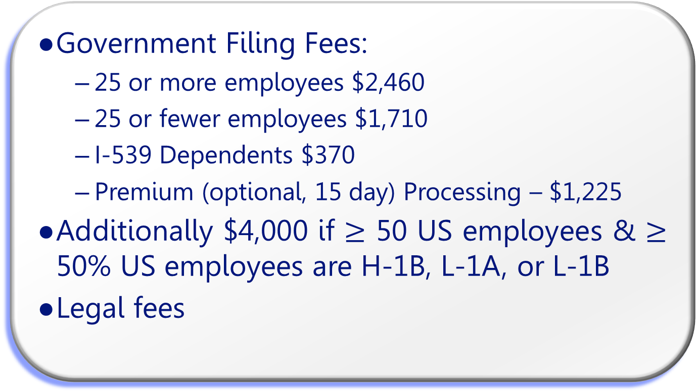
H-1B Fees
Government Filing Fees:
  25 or more employees $2,460
  25 or fewer employees $1,710
  I-539 Dependents $370
  Premium (optional, 15 day) Processing – $1,225
Additionally $4,000 if $≥$ 50 US employees & $≥$ 50% US employees are H-1B, L-1A, or L-1B
Legal fees

Slide 26
H-1B Labor Condition Application (LCA)
Often confused with the Labor Certification recruitment process (Job ads), which employers are generally reluctant to deal with
The sponsor company is required to pay the prevailing wage and notify its employees that a foreign national is being hired
The company must complete the LCA notice, post this LCA information, and provide a copy to the H-1B

Slide 27
H-1B Visa
Travel outside the US requires a visa stamp with the properly matching category to return
  May have multiple valid visas at a time
  Be sure to use the correct one
An H-1B approval is required to get an H-1B visa
Apply at home or permitted consulate
Plan in advance as seasonal changes may affect the timing of scheduling and processing, taking about a week or two

Slide 28
H-1B Dual Intent
One of the great advantages of the H-1B is the benefit of Dual Intent, which allows the foreign national to concurrently maintain non-immigrant status while at the same time applying for permanent immigration to the U.S.
This is generally not allowed, as immigrant intent precludes a foreign national’s qualification for many non-immigrant classifications, such as B Visitors and F Students

Slide 29
H-1B General TimeLine
Properly Filed - 1st week April
  Courier Receipt
Selected - end May
Approved
  Premium Processing: May/June (Suspended in 2017)
  standard maybe late June, but mostly later, most August, Sept
Rejected – July or later
Denied, or Revoked - varies

Slide 30
Texas DPS &
H-1B Extensions
Texas DPS requires an approval notice as they issue Driver Licenses that mirror the H-1B validity dates.
USCIS processing times on extensions can run up to 5 months or more
Try to avoid Premium Processing costs by filing extensions early
SAVE Verification issues
  Possible 2 week delay
  Approval may not be updated in DPS online system
Harry Gee & Associates, PLLC

Slide 31
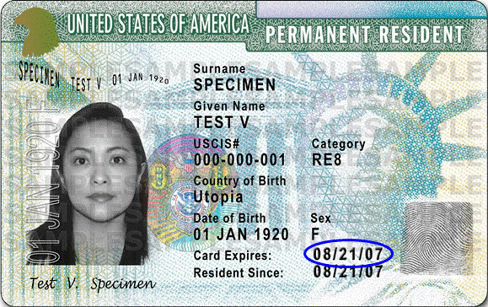
Immigrant Categories Review
Lawful Permanent Resident
OR
The Green Card

Slide 32
Employment-based Immigration
EB-1 – Extraordinary / Outstanding
EB-2 – Certain Professionals
NIW – National Interest Waiver
EB-3 – General Workers
PERM: Labor Certification (Recruitment Process)
Visa Bulletin

Slide 33
EB-1 Persons of Extraordinary Ability
Extraordinary ability in sciences, arts, education, business or athletics (allows self-sponsorship and Premium Processing)
Qualifies with major award (Nobel Prize)
  Alternately a combination of USCIS criteria: national/international awards, published works, membership requiring outstanding achievement, commands high salary compared to others in field, & similar
  Intended for small percentage at top of field

Slide 34
EB-1 Outstanding Professors/Researchers
Internationally recognized as outstanding in specific academic area with at least 3 years of experience in teaching or research in area, for specific teaching or research position
Evidence includes at least 2 from list of criteria such as major awards, published material, original scientific research, etc.
Typically for those at or beyond PhD
Premium Processing possible
03/08/2017

Slide 35
EB-2 Certain Professionals
Members of the professions with advanced degrees (Master’s) or the equivalent (Bachelor’s plus 5 years of progressive experience)
Aliens of exceptional ability in sciences, art, or business
Requires PERM Labor Certification or Waiver if the alien’s services are in the National Interest

Slide 36
EB-2 National Interest Waiver - NIW
Seeks employment in area of substantial intrinsic merit; Benefit will be national in scope; and National interest would be adversely affected if labor certification were required
Must show benefit of unique skills substantially outweighs inherent interest in protecting US workers through labor certification process
Allows self-sponsorship

Slide 37
EB-3 General Workers
Pertinent Category : those with Bachelor’s degrees & who hold professional jobs
Must obtain labor certifications from the Department of Labor that:
  There are not sufficient US workers who are able, willing, qualified, and available to do the work
  The employment of the alien will not adversely affect the wages and working conditions of US workers similarly employed.

Slide 38
PERM Labor Certification
Complex and highly technical computerized system
  Form is 10-15+ pages
  Minor variations often result in application denial
Theoretical 45-60 day processing, currently about 9 months initially and frequently additional 6-12 months for Audits
Based on prevailing wage determined by job duties and geographic location

Slide 39
PERM Labor Certification
Substantial recruitment to be done 30-180 prior to submission of PERM application
  30 day job order with DOL
  2 Sunday ads in largest local newspaper or professional positions may substitute one Sunday ad for an appropriate trade journal
  3 additional recruitments from DOL list of 10
All applicants must be shown to not qualify or reject the terms

Slide 40
Visa Bulletin
March 2017 – Final Action
Employment Based | All Chargeability Areas Except Those Listed | CHINA - mainland born | EL SALVADOR GUATEMALA HONDURAS | INDIA | MEXICO | PHILIPPINES
1st | C | C | C | C | C | C
2nd | C | 15DEC12 | C | 01JUN08 | C | C
3rd | 01DEC16 | 15MAR14 | 01DEC16 | 22MAR05 | 01DEC16 | 15MAR12
Other Workers | 01DEC16 | 15FEB06 | 01DEC16 | 22MAR05 | 01DEC16 | 15MAR12
03/08/2017

Slide 41
Harry Gee & Associates, PLLC
Presentation
www.HarryGee.com/UH2017
Additional information
www.HarryGee.com/Expertise
5847 San Felipe, Ste 2950
Houston TX 77057
713.781.0071
03/08/2017

